Slide 1
Virtual Memory
60080013: Computer Organization
8th Lecture, 2022
Instructors:
Sun Heng

Slide 2
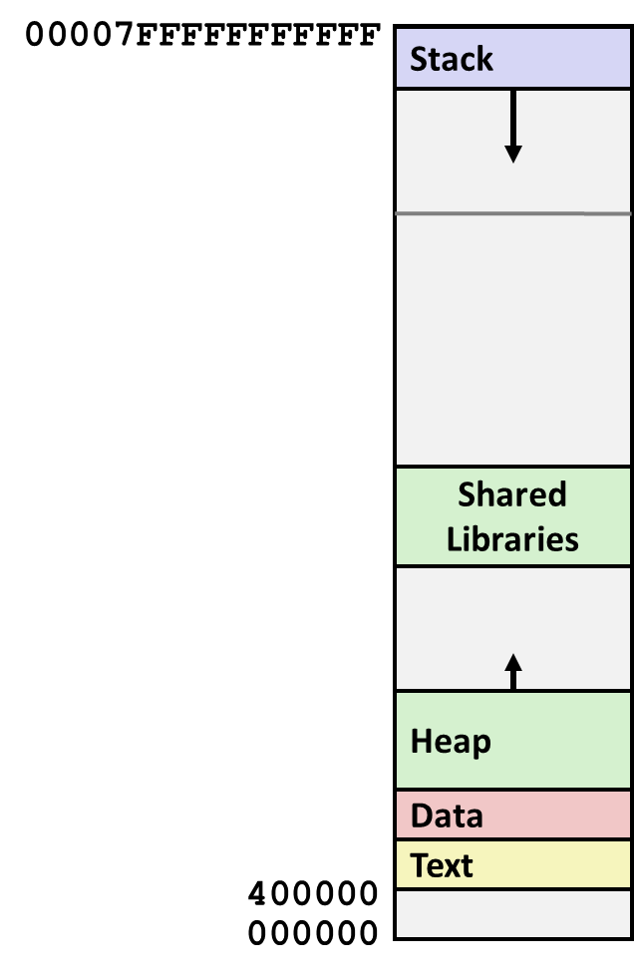
Hmmm, How Does This Work?!
Process 1
Process 2
Process n
Solution: Virtual Memory

Slide 3
A System Using Physical Addressing
Main memory
0:
1:
Physical address
(PA)
2:
CPU
3:
4
4:
5:
6:
7:
8:
...
M-1:
Data word
Used in some “simple” systems, like embedded microcontrollers in cars, elevators, and digital picture frames

Slide 4
A System Using Virtual Addressing
Main memory
0:
CPU Chip
1:
Virtual address
(VA)
Physical address
(PA)
2:
CPU
MMU
3:
4
4:
4100
5:
6:
7:
8:
...
M-1:
Data word
Used in all modern servers, desktops, and laptops
One of the great ideas in computer science

Slide 5
Address Spaces
Linear address space: Ordered set of contiguous non-negative integer addresses:
{0, 1, 2, 3 … }
Virtual address space: Set of N = 2^{n} virtual addresses
{0, 1, 2, 3, …, N-1}
Physical address space: Set of M = 2^{m} physical addresses
{0, 1, 2, 3, …, M-1}
Clean distinction between data (bytes) and their attributes (addresses)
Each datum can now have multiple addresses
Every byte in main memory:
one physical address, one (or more) virtual addresses

Slide 6
VM as a Tool for Caching
Virtual memory is an array of N contiguous bytes that may be stored on disk
The contents of the array on disk are cached in physical memory (DRAM cache)
  These cache blocks are called pages (size is P = 2^{p} bytes)
Virtual memory
Physical memory
VP 0
Unallocated
0
VP 1
Cached
0
Empty
PP 0
Uncached
PP 1
Unallocated
Empty
Cached
Uncached
Empty
Cached
M-1
PP 2^{m-p}-1
VP 2^{n-p}-1
Uncached
N-1
Virtual pages (VPs)
stored on disk
Physical pages (PPs)
cached in DRAM

Slide 7
DRAM Cache Organization
DRAM cache organization driven by the enormous miss penalty
  DRAM is about 10x slower than SRAM
  Disk is about 10,000x slower than DRAM
  Time to load block from disk > 1ms (> 1 million clock cycles)
    CPU can do a lot of computation during that time
Consequences
  Large page (block) size: typically 4 KB, sometimes 4 MB
  Highly sophisticated, expensive replacement algorithms
    Too complicated and open-ended to be implemented in hardware
  Write-back rather than write-through

Slide 8
Enabling data structure: Page Table
A page table is an array of page table entries (PTEs) that maps virtual pages to physical pages
  Per-process kernel data structure in DRAM
Physical memory
(DRAM)
Physical page
number or
disk address
Valid
VP 1
PP 0
PTE 0
0
null
VP 2
1
VP 7
VP 4
PP 3
1
0
1
0
null
Virtual memory
(disk)
0
PTE 7
1
VP 1
Memory resident
page table
(DRAM)
VP 2
VP 3
VP 4
VP 6
VP 7

Slide 9
Page Hit
Page hit: reference to VM word that is in physical memory (DRAM cache hit)
Physical memory
(DRAM)
Physical page
number or
disk address
Virtual address
Valid
VP 1
PP 0
PTE 0
0
null
VP 2
1
VP 7
VP 4
PP 3
1
0
1
0
null
Virtual memory
(disk)
0
PTE 7
1
VP 1
Memory resident
page table
(DRAM)
VP 2
VP 3
VP 4
VP 6
VP 7

Slide 10
Page Fault
Page fault: reference to VM word that is not in physical memory (DRAM cache miss)
Physical memory
(DRAM)
Physical page
number or
disk address
Virtual address
Valid
VP 1
PP 0
PTE 0
0
null
VP 2
1
VP 7
VP 4
PP 3
1
0
1
0
null
Virtual memory
(disk)
0
PTE 7
1
VP 1
Memory resident
page table
(DRAM)
VP 2
VP 3
VP 4
VP 6
VP 7

Slide 11
Handling Page Fault
Page miss causes page fault (an exception)
Physical memory
(DRAM)
Physical page
number or
disk address
Virtual address
Valid
VP 1
PP 0
PTE 0
0
null
VP 2
1
VP 7
VP 4
PP 3
1
0
1
0
null
Virtual memory
(disk)
0
PTE 7
1
VP 1
Memory resident
page table
(DRAM)
VP 2
VP 3
VP 4
VP 6
VP 7

Slide 12
Handling Page Fault
Page miss causes page fault (an exception)
Page fault handler selects a victim to be evicted (here VP 4)
Physical memory
(DRAM)
Physical page
number or
disk address
Virtual address
Valid
VP 1
PP 0
PTE 0
0
null
VP 2
1
VP 7
VP 4
PP 3
1
0
1
0
null
Virtual memory
(disk)
0
PTE 7
1
VP 1
Memory resident
page table
(DRAM)
VP 2
VP 3
VP 4
VP 6
VP 7

Slide 13
Handling Page Fault
Page miss causes page fault (an exception)
Page fault handler selects a victim to be evicted (here VP 4)
Physical memory
(DRAM)
Physical page
number or
disk address
Virtual address
Valid
VP 1
PP 0
PTE 0
0
null
VP 2
1
VP 7
VP 3
PP 3
1
1
0
0
null
Virtual memory
(disk)
0
PTE 7
1
VP 1
Memory resident
page table
(DRAM)
VP 2
VP 3
VP 4
VP 6
VP 7

Slide 14
Handling Page Fault
Page miss causes page fault (an exception)
Page fault handler selects a victim to be evicted (here VP 4)
Offending instruction is restarted: page hit!
Physical memory
(DRAM)
Physical page
number or
disk address
Virtual address
Valid
VP 1
PP 0
PTE 0
0
null
VP 2
1
VP 7
VP 3
PP 3
1
1
0
0
null
Virtual memory
(disk)
0
PTE 7
1
VP 1
Memory resident
page table
(DRAM)
VP 2
VP 3
VP 4
VP 6
VP 7

Slide 15
Allocating Pages
Allocating a new page (VP 5) of virtual memory.
Subsequent miss will bring it into memory
Physical memory
(DRAM)
Physical page
number or
disk address
Valid
VP 1
PP 0
PTE 0
0
null
VP 2
1
VP 7
VP 3
PP 3
1
1
0
0
Virtual memory
(disk)
0
PTE 7
1
VP 1
Memory resident
page table
(DRAM)
VP 2
VP 3
VP 4
VP 5
VP 6
VP 7

Slide 16
Locality to the Rescue Again!
Virtual memory works because of locality
At any point in time, programs tend to access a set of active virtual pages called the working set
  Programs with better temporal locality will have smaller working sets
If (working set size < main memory size)
  Good performance for one process after compulsory misses
If ( SUM(working set sizes) > main memory size )
  Thrashing: Performance meltdown where pages are moved (copied) in and out continuously

Slide 17
VM as a Tool for Memory Management
Key idea: each process has its own virtual address space
  It can view memory as a simple linear array
  Mapping function scatters addresses through physical memory
    Well-chosen mappings can improve locality
0
Address
translation
0
Virtual Address Space for Process 1:
Physical
Address
Space (DRAM)
VP 1
VP 2
PP 2
...
N-1
PP 6
(e.g., read-only
library code)
Virtual Address Space for Process 2:
0
PP 8
VP 1
VP 2
...
...
N-1
M-1

Slide 18
VM as a Tool for Memory Protection
Extend PTEs with permission bits
MMU checks these bits on each access
Physical
Address Space
Process i:
SUP
READ
WRITE
Address
VP 0:
No
Yes
No
PP 6
VP 1:
No
Yes
Yes
PP 4
VP 2:
Yes
Yes
Yes
PP 2
PP 2
•
•
•
PP 4
PP 6
Process j:
SUP
READ
WRITE
Address
PP 8
VP 0:
No
Yes
No
PP 9
PP 9
VP 1:
Yes
Yes
Yes
PP 6
VP 2:
No
Yes
Yes
PP 11
PP 11

